Slide 1
GoTo IEnumerable considered harmful
Goran Šiška (Siopti d.o.o.)

Slide 2
Enumerable
IEnumerable
IEnumerator
Collection
Items
GetEnumerator()
Iterator
Current item
MoveNext()

Slide 3
Enumerable
IGeneratable
IGenerator
Collection
Items
GetGenerator()
Generator
Current item
MoveNext()

Slide 4
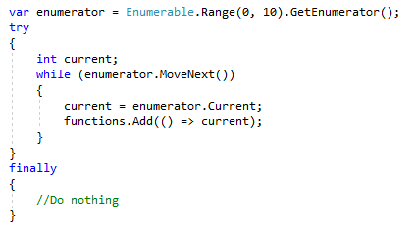
foreach actually

Slide 5
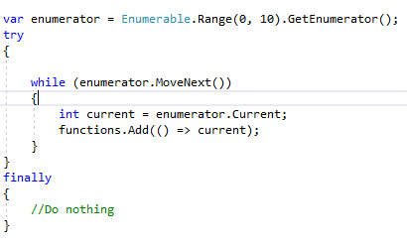
foreach actually

Slide 6
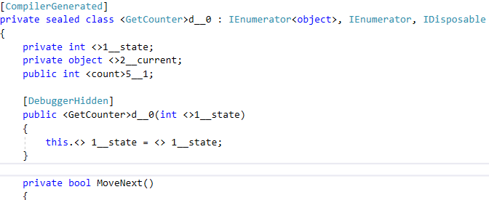
yield actually

Slide 7
foreach vs ForEach()
„The first reason is that doing so (ForEach()) violates the functional programming principles that all the other sequence operators are based upon. Clearly the sole purpose of a call to this method is to cause side effects.“
Eric Lippert

Slide 8
Common mistakes
Late Evaluation
Multiple Evaluation
Instance Evaluation
Infinite Evaluation
Order Of Evaluation
Partial Evaluation

Slide 9
Lessons learned
Enumerable is „lazy“
Iterating is generating
Re-evaluation re-instantiates
Infinite sequences are bad
Context may vary
Side effects best be avoided

Slide 10
SourceCode
https://github.com/GoranSiska/IEnumerableConsideredHarmful

Slide 11
Lack of UnitTests considered harmful

